Slide 1
EE746 Neuromorphic Engineering
Udayan Ganguly
udayan@ee.iitb.ac.in
Aug, 3, 2023
Notes:
Welcome to EE746!
The course is taught by Udayan Ganguly.

Slide 2
Why Neuromorphic Engineering?
For Self
For Humanity
Or why not?

Slide 3
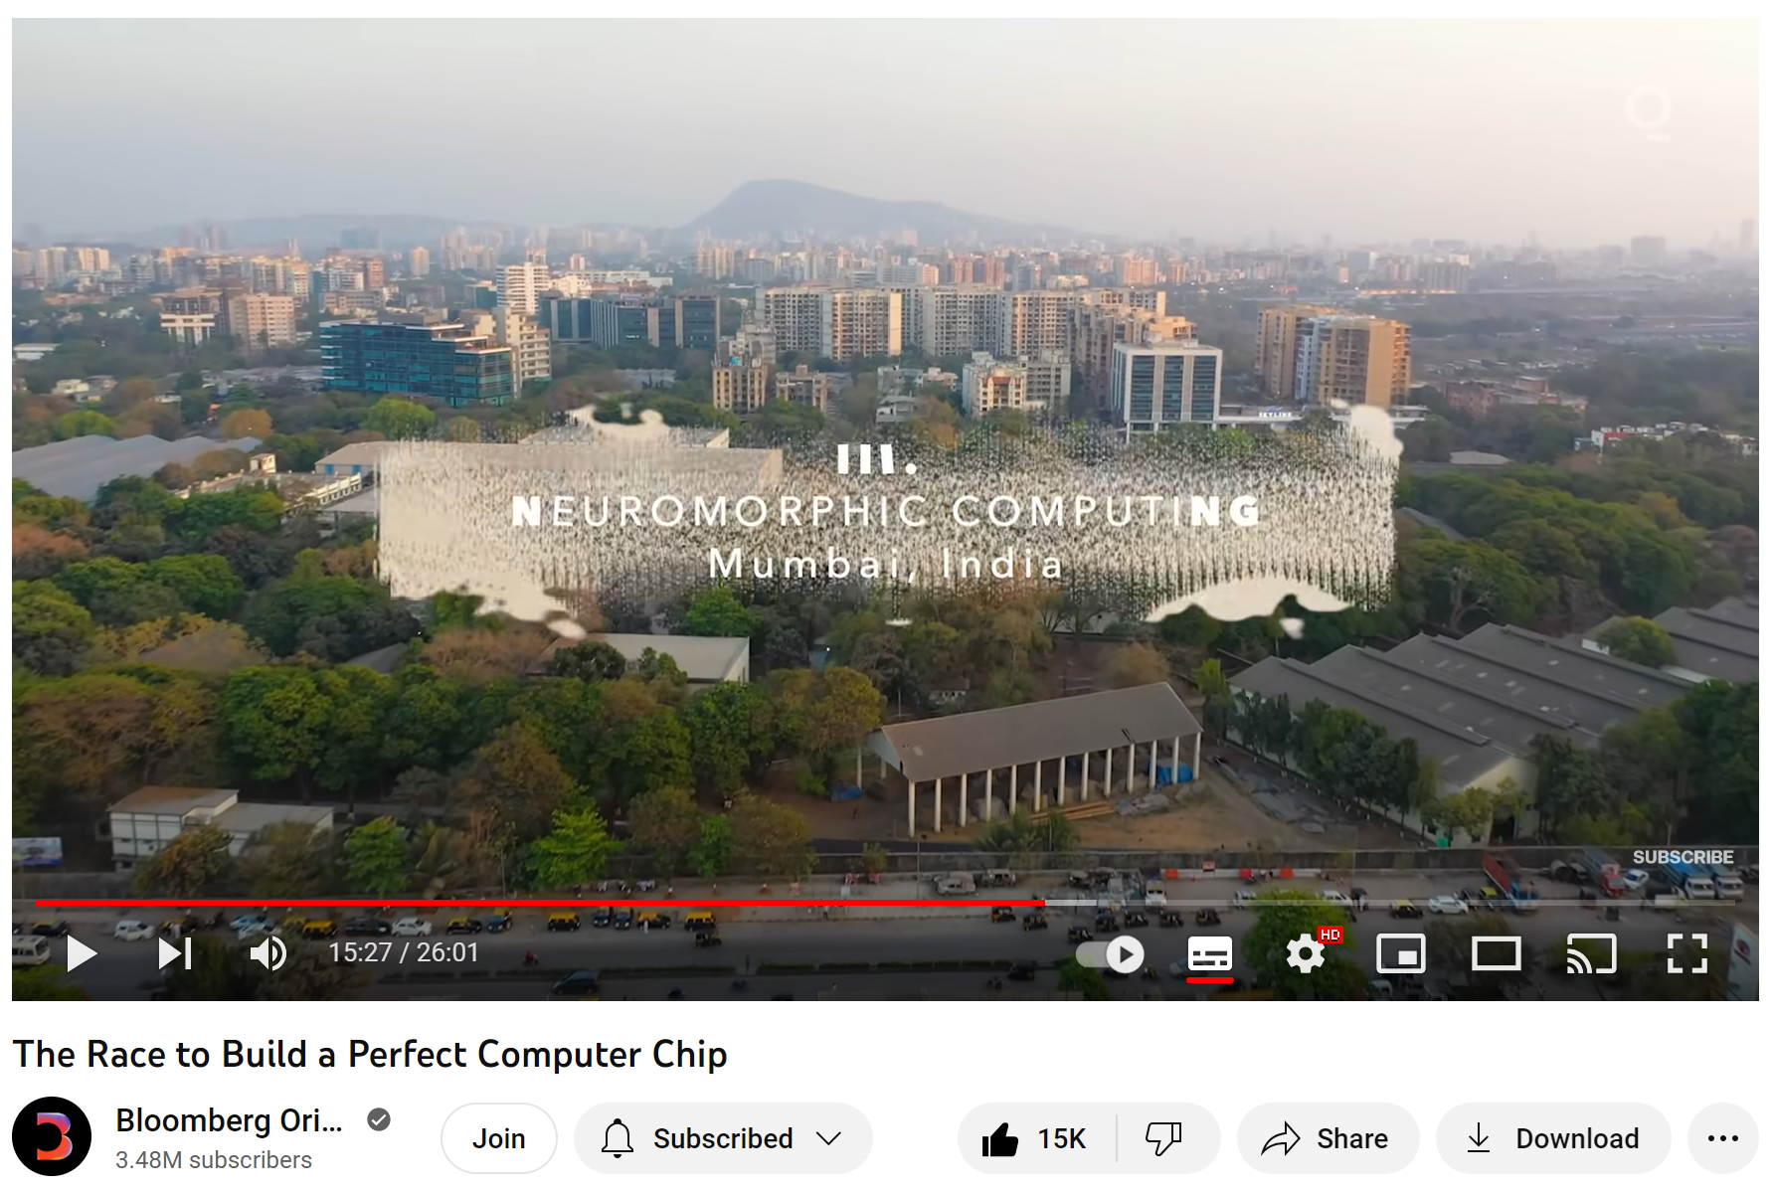
Who am I?
Please visit our group’s webpage
https://nanomemorylogic.wordpress.com/
https://youtu.be/VsUF_CBJq50?t=925

Slide 4

Myself
Education
Ph.D. Materials Science and Engineering Cornell University, 2006
M.S., Materials Science and Engineering Cornell University, 2005
B. Tech., Metallurgical Engineering Indian Institute of Technology Madras (IITM), 2000
IIT Bombay 2010- current
Applied Materials 2006-2010
NASA Ames Research 2006

Slide 5
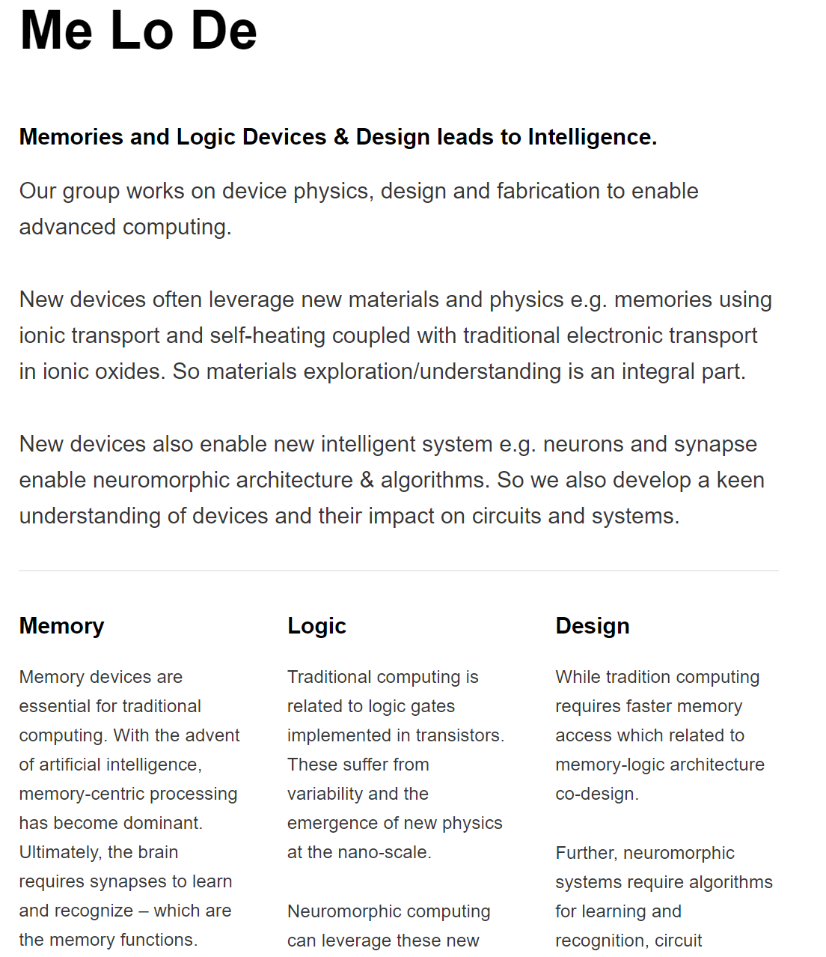

Slide 6
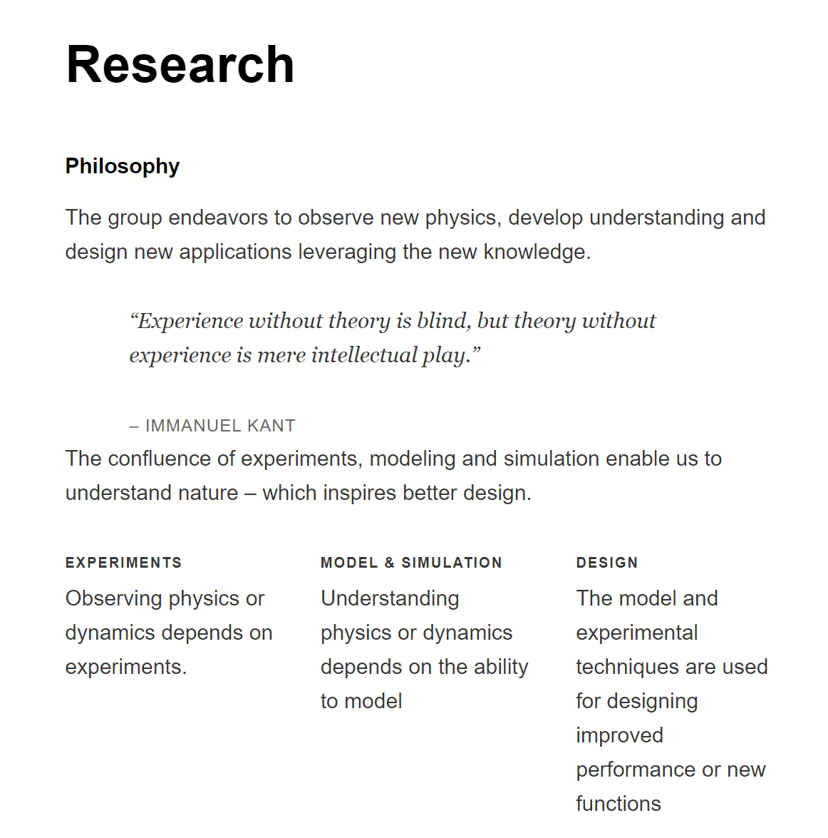

Slide 7


How do we learn? about learning?
SNNs or ourselves?
Think: To understand an Idea by yourself
Pair: To collaboratively learn with your buddies from a nebulous stage
How can my buddies get it right? I am surely better, aren’t I ?
OR
Can I further refine my buddies ideas and create a greater idea?
Share: To present a matured thesis and understand its strength/weaknesses
After all, ______ not _______ must win! (in a civilized world … not wild west!)

Slide 8
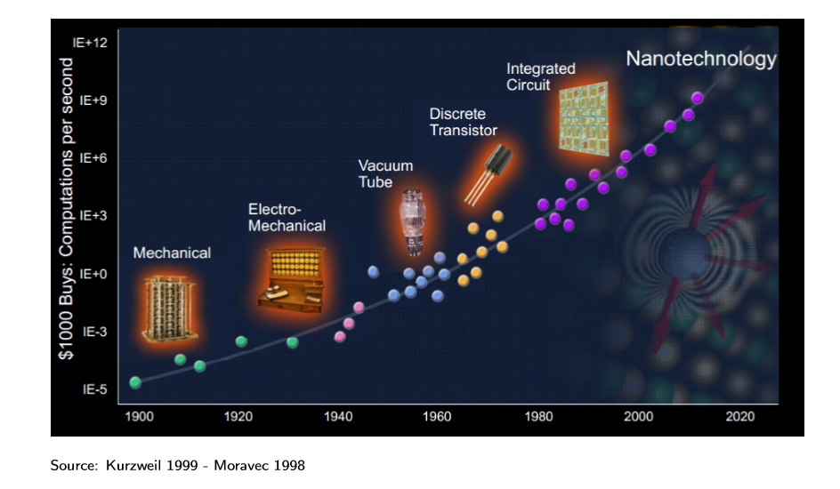
Exponential Growth in Computing
GHz
MHz
Q: Can you see any point on the graph that makes sense?
A: Computer (~75k INR~1kUSD @ 1GHz)
Notes:
Every step is essentially a step jump to enable more computing
Mechanical ➔ abacus:
Electromechanical ➔ Relay (mechanical switch)
Vacuum tube ➔ electrons in vac (transistor)
Discrete ➔ electrons in solid state (small transistor – low barrier modulation)
IC ➔ connections are simpler, shorter, denser
Nano ➔ each transistor is smaller, faster
This has lead to a great reduction of cost of computing. In fact, it is an exponential increase in computing power achieved in linear time. This is one of fastest growing technologies created by humans!

Slide 9
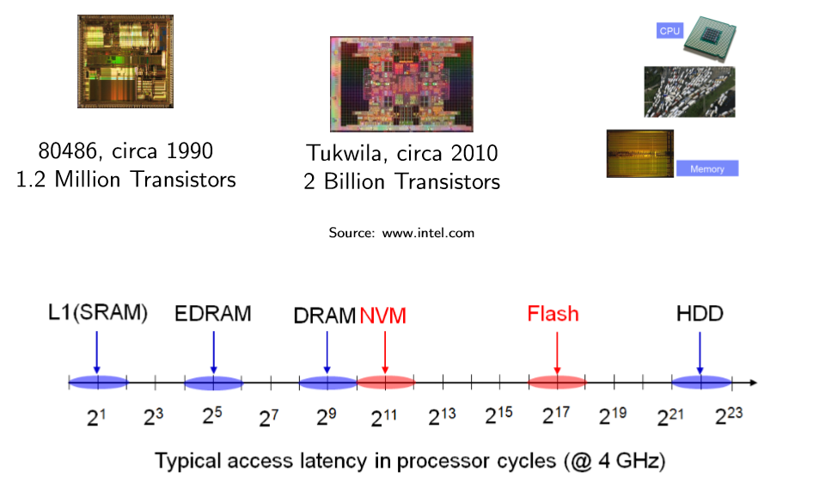

Micro-processor data access timescales from Memory
ns
us
ms
s
Prof. M Qureshi
Notes:
Memory is required for logic operation; Input to Logic operations (adds/multiplies) is bits and output (result) is bits; So logic needs to call on memory and submit results back to memory;
Memory speed must complement logic; Latency is time to access memory;
Memory size should support logic; All logic operations in time are cumulatively stored in a memory;
So memory size is normally larger than logic size; Memory is needed at different frequency e.g. photos are called rarely but computer program codes (stored in memory) are called with great speed;
Fast memory is expensive and hence small in capacity; Slow memory is cheap but dense- hence large in capacity; Hence a memory hierarchy is used – from fast/small to slow/big for best performance for a specific application.
What are the requirements for electronics?
So small and fast and better integrated (large area) is the push for electronics;
Do we want computers to remember – slow loss ? To forget – fast loss?
Do we want humans to remember? To forget?

Slide 10
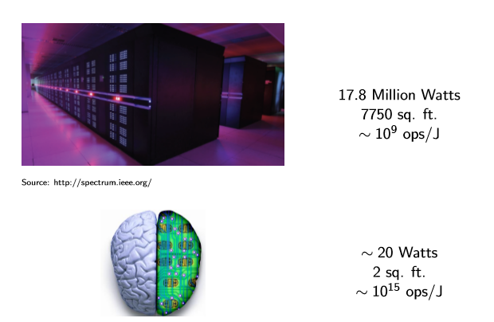
Computation – A comparison
Think: How do we “verify” the energy, area and energy efficiency for computer?
Pair: How do we do the same for the brain?
Notes:
The Watson is the pinnacle of human-made computing; How does it compare with nature?
Lets us use three metrics
1. Initial Cost ➔ one time investment (not considered)
2. Recurring Cost ➔ space and energy
3. Return on investment ➔ computing operations / unit of energy
<Discussion Exercise – Think- Pair- Share>
Challenge: For a computer, this is easy to estimate. For power and space, find room size and use a power meter respectively. For Efficiency, count the number of operations (standard terms). But how does one do it for nature?
Since the equivalence to biology is not obvious at first shot, or cannot be measured directly, we need to use Fermi’s method of estimation – (Fermi Problem- https://en.wikipedia.org/wiki/Fermi_problem)
Area: The brain is a sheet that is crumpled to fit the skull. The crumpling is a specific and enables connections between neighboring folds (https://en.wikipedia.org/wiki/Human_brain). If we spread it, we can measure it.
Power:
We are consuming food (in kCal or J). This is the upper bound of energy that the brain can use; We can choose a fraction (say by volume as a first guess) to estimate energy;
We can measure heat loss (all energy must be lost as heat) ➔ not a good assumption
We can measure the inflow of chemicals associated with energy use (e.g. extent of ATP in blood or oxygen); Again, this will provide an upper bound (but better than #1);
Energy per operation: This has two questions
What is an operation in a brain that that equivalent to a computer?
What is the energy consumed by the brain for specifically that operation?
Here are a few approaches to estimate the first one
Equate spikes to the bits; measure number of spikes; (this approach looks at observing the internal states of the brain)
Find a task (like speech recognition) which a computer can do; assume that the brain does an equivalent number of operations (this approach looks at the output of two system and assumes that the internal states must be equivalent or close)
Others?
**************
Exercise
**************
Criticize the estimations above; based on these weaknesses, try to improve them. (This is a systematic approach to improving your estimates)
The energy for this operation specifically is difficult. But then what is easy ☺ ; Please write down the possibilities here; Check out my guesses in the next slide

Slide 11
Discussion
Power
Area
Energy Efficiency

